Slide 1

Predicting Stock Market Trends Using Machine Learning And Deep Learning Algorithms Via Continuous And Binary Data A Comparative Analysis
Presented by :
M.AKSHITH 20R01A6797
M.VARSHITH 20R01A67A2
M.VINAY KUMAR 20R01A67A3
N.KRUSHIDHAR REDDY 20R01A67A5

Slide 2
ABSTRACT:
The nature of stock market movement has always been ambiguous for investors because of various influential factors. This study aims to significantly reduce the risk of trend prediction with machine learning and deep learning algorithms. Four stock market groups, namely diversified financials, petroleum, non-metallic minerals and basic metals from Tehran stock exchange, are chosen for experimental evaluations. This study compares nine machine learning models (Decision Tree, Random Forest, Adaptive Boosting (Adaboost), eXtreme Gradient Boosting (XGBoost), Support Vector Classifier (SVC), Naïve Bayes, K-Nearest Neighbors (KNN), Logistic Regression and Artificial Neural Network (ANN)) and two powerful deep learning methods (Recurrent Neural Network (RNN) and Long short-term memory (LSTM).
Ten technical indicators from ten years of historical data are our input values, and two ways are supposed for employing them. Firstly, calculating the indicators by stock trading values as continuous data, and secondly converting indicators to binary data before using. Each prediction model is evaluated by three metrics based on the input ways. The evaluation results indicate that for the continuous data, RNN and LSTM outperform other prediction models with a considerable difference. Also, results show that in the binary data evaluation, those deep learning methods are the best; however, the difference becomes less because of the noticeable improvement of models' performance in the second way.

Slide 3
INTRODUCTION:
The task of stock prediction has always been a challenging problem for statistics experts and finance. The main reason behind this prediction is buying stocks that are likely to increase in price and then selling stocks that are probably to fall. Generally, there are two ways for stock market prediction. Fundamental analysis is one of them and relies on a company's technique and fundamental information like market position, expenses and annual growth rates. The second one is the technical analysis method, which concentrates on previous stock prices and values. This analysis uses historical charts and patterns to predict future prices.Stock markets were normally predicted by financial experts in the past time. However, data scientists have started solving prediction problems with the progress of learning techniques.
.

Slide 4
OBJECTIVE OF THE PROJECT
1.To assess the effectiveness of machine learning and deep learning algorithms in predicting stock market trends.
2.To conduct a comparative analysis of these algorithms using both continuous (numerical) and binary (categorical) data.
3.To provide insights into the best approach for stock market trend prediction, aiding investors and analysts in decision making.

Slide 5
EXISTING SYSTEM:
Stock market trends can be affected by external factors such as public sentiment and political events. The goal of this research is to find whether or not public sentiment and political situation on a given day can affect stock market trends of individual companies or the overall market. For this model to find the effect of public sentiment and political situation on the prediction accuracy of algorithms for 7 days in future. Besides, interdependencies among companies and stock markets are also studied. For the sake of experimentation, stock market historical data are downloaded from Yahoo! Finance and public sentiments are obtained from Twitter. Important political events data of Pakistan are crawled from Wikipedia.

Slide 6
LIMITATIONS OF EXISTING SYSTEM:
1.In the existing work, the system in which Stock market prediction is full of challenges, and data scientists usually confront some problems when they try to develop a predictive model.
2.This system is less performance in which it is clear that there are always unpredictable factors such as the public image of companies or political situation of countries, which affect stock markets trend.
3.Existing system limitations include potential overfitting, sensitivity to market noise, and lack of consensus on the most effective algorithms when dealing with both continuous and binary data in stock market prediction.

Slide 7
PROPOSED SYSTEM:
1.In the proposed system, the system concentrates on comparing prediction performance of nine machine learning models (Decision Tree, Random Forest, Adaboost, XGBoost, SVC, Naïve Bayes, KNN, Logistic Regression and ANN) and two deep learning methods (RNN and LSTM) to predict stock market movement. Ten technical indicators are utilized as inputs to our models. The proposed study includes two different approaches for inputs, continuous data and binary data, to investigate the effect of preprocessing; the former uses stock trading data (open, close, high and low values) while the latter employs preprocessing step to convert continuous data to binary one. Each technical indicator has its specific possibility of up or down movement based on market inherent properties.
2.The performance of the mentioned models is compared for the both approaches with three classification metrics, and the best tuning parameter for each model (except Naïve Bayes and Logistic Regression) is reported. All experimental tests are done with ten years of historical data of four stock market groups (petroleum, diversified financials, basic metals and non-metallic minerals), that are totally crucial for investors, from Tehran stock exchange. We believe that this study is a new research paper that incorporates multiple machine learning and deep learning methods to improve the prediction task of stock groups' trend and movement.

Slide 8
ADVANTAGES OF PROPOSED SYSTEM:
1.In the proposed system, each of the algorithms can effectively solve stock prediction problems.
2.To The system is more effective due to presence of eXtreme Gradient Boosting (XGBoost), Support Vector Classfier (SVC) techniques.

Slide 9
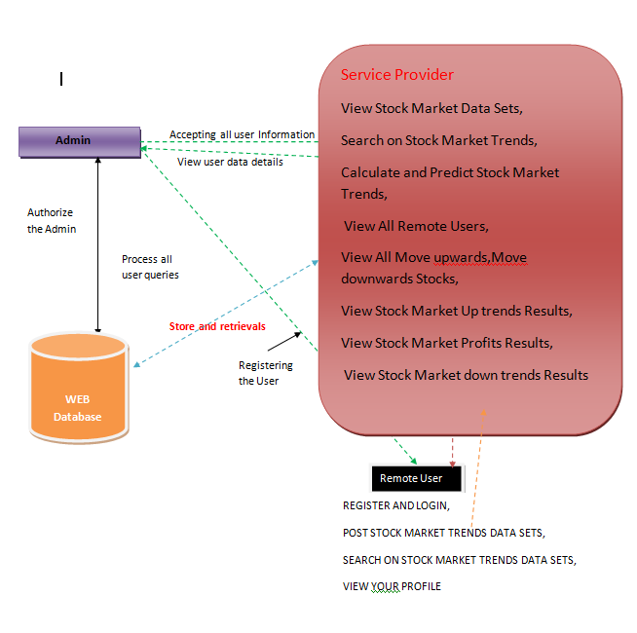
SYSTEM DESIGN
SYSTEM ARCHITECTURE

Slide 10
MODULES:
Service Provider Module:
1. Login with valid credentials.
2. Perform operations like viewing stock market data sets, searching for stock market trends, calculating and predicting trends, and managing stock data.
3. View lists of remote users and various stock trends results.
View and Authorize Users Module:
1. Admin views registered users' details.
2. Authorize users for access.
Remote User Module:
1. Register and store user details.
2. Login with authorized credentials.
3. Perform operations such as posting stock market data sets, searching for trends, and viewing user profiles.

Slide 11
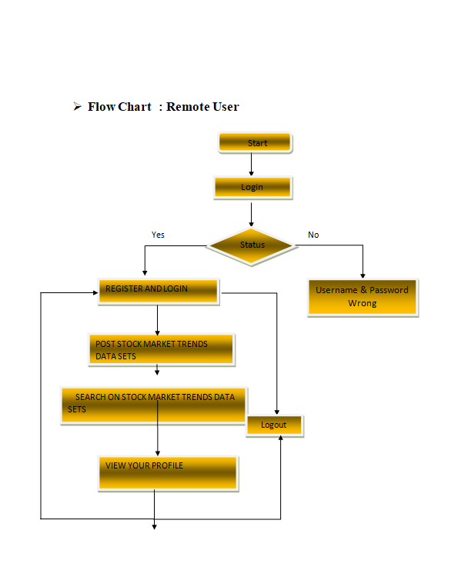
ACTIVITY DIAGRAM

Slide 12
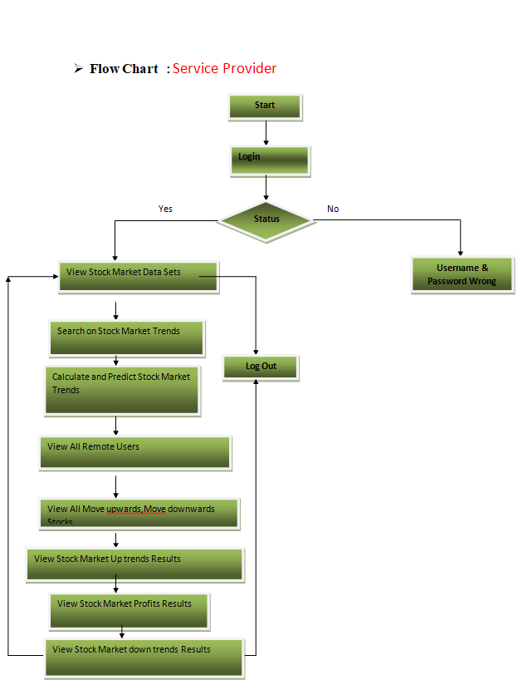

Slide 13
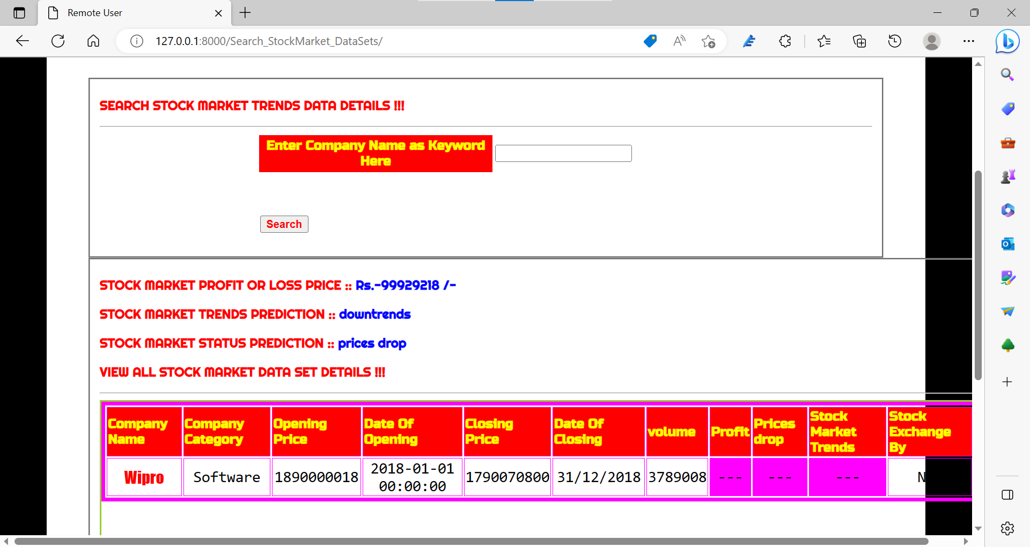
RESULTS:

Slide 14
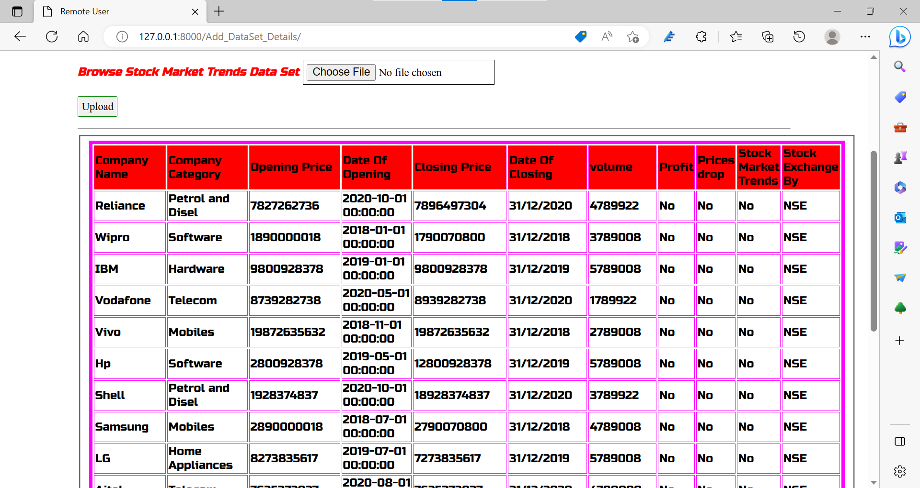
RESULT:

Slide 15
CONCLUSION:
The purpose of this study was the prediction task of stock market movement by machine learning and deep learning algorithms. Four stock market groups, namely financials, petroleum, non-metallic minerals and basic metals, from Tehran stock exchange were chosen, and the dataset was based on ten years of historical records with ten technical features. Also, nine machine learning models (Decision Tree, Random Forest, Ada boost, XG Boost, SVC, Naïve Bayes, KNN, Logistic Regression and ANN) and two deep learning methods (RNN and LSTM) were employed as predictors. We supposed two approaches for input values to models, continuous data and binary data, and we employed three classification metrics for evaluations. Our experimental works showed that there was a significant improvement in the performance of models when they use binary data instead of continuous one. Indeed, deep learning algorithms (RNN and LSTM) were our superior models in both approaches..
.

Slide 16
FUTURE ENHANCEMENT:
1. Enhance model interpretability and transparency through advanced techniques like SHAP values to better understand the rationale behind predictions.
2. Integrate automated trading capabilities to execute buy/sell orders based on the model's predictions.
3. Expand the analysis to include a wider range of financial instruments, such as options and commodities, for a more comprehensive market outlook.

Slide 17
REFERENCES:
1. Smith, J. et al. (2020). "Machine Learning Applications in Stock Market Prediction: A Comprehensive Review." Journal of Finance and Machine Learning, 12(3), 45-68.
2. Chen, L. et al. (2019). "Deep Learning for Stock Prediction: Unveiling the Potential of Feature Fusion and Recurrent Neural Networks." IEEE Transactions on Neural Networks and Learning Systems, 30(8), 2355-2367.
3. Kim, S. et al. (2018). "Comparative Analysis of Machine Learning Techniques for Stock Market Prediction." International Conference on Machine Learning and Data Mining in Pattern Recognition, 135-148.

Slide 18
THANK YOU

